Slide 1
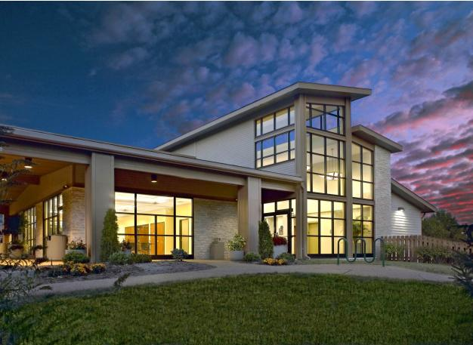
City-County Merger Informational Meeting
Impact
on Ellisville
March
2019

Slide 2
Disclaimer…
This presentation was originally prepared based upon the Better Together Report issued on January 25, 2019 and based on the ballot language submitted to the Secretary of State by Better Together on January 25, 2019. The initiative petition language was withdrawn on Friday, February 8th by Better Together and was re-submitted on February 13th and withdrawn again on March 22nd and re-submitted on March 26th incorporating various changes.
And the Freeholders Initiative Petition issued by the Municipal League of Metro St. Louis, on February 14, 2019.
This presentation represents a general summary of the Better Together city-county merger proposal and the Freeholders Initiative Petition proposal as interpreted by city staff. The information is intended to provide a fair and objective presentation of the facts regarding the Better Together petition, as the City is prohibited from using public resources to support or oppose any ballot measure.
2

Slide 3
What is “Better Together”?
Better Together is a task force which has recently proposed a dramatic change to the government structure of St. Louis City and St. Louis County, along with all of the municipalities in the County.
The proposal calls for a Statewide Vote on a Constitutional Amendment in November 2020.
If Passed in November 2020, Effective Date is January 1, 2021.
Creates a new class of city – “A Metropolitan City”
Merge St. Louis City & St. Louis County as a Metropolitan City
Cities in St. Louis County (like Ellisville) to become “Municipal Districts” of the Metropolitan City
Transition period of two years to full implementation in January 2023
First elections for Metropolitan City Council in November 2022, and take office January 2023
First elections for Metro Mayor, Prosecutor and Assessor in November 2022, and take office January 2023
3

Slide 4

Metro City of St. Louis
The proposal is to change the Missouri State Constitution by combining St. Louis City, County and all municipalities into one government called Metro St. Louis.
All existing cities (including Ellisville) to become Municipal Districts
Partisan Elections for all positions in Metropolitan City
Metropolitan City headed by elected Mayor (4 year term – 2023-2026)
Metropolitan City Council Composed of 33 elected Councilmen by districts (2&4 year terms – 2023-24 for half and 2023-26 for other half)
Prosecutor and Assessor independently elected at large
During the transition – St. Louis County officials are Interim Mayor, Prosecutor & Assessor; Mayor of St. Louis to be “Transitional Mayor” who jointly with the Interim Mayor (County Executive) shall constitute “the chief executive officer of the metropolitan city”
4

Slide 5

November 2020
In order to change the Missouri Constitution to allow such a merger, Better Together is pushing for a state-wide vote in November of next year.
This would mean that every Missourian would have a vote on changing the governmental structure in St. Louis County and City, instead of just those citizens who live here.
5

Slide 6

Municipalities Become Municipal Districts
A municipality shall continue its corporate existence as a “municipal district”
“Municipal Districts” will be severely restricted in service responsibilities (Fire-EMS, Parks & Rec, and Enterprise Funds – Utilities, Trash, etc.)
Governing body of existing municipalities at time of adoption of plan (January 2021 to be governing body of municipal districts in office on January 2021 to remain in office until April 2023) (Municipal Elections in 2021 and 2022 are cancelled)
Budgets for municipal districts to be submitted annually for review and approval of Metro City. Transitional budgets for 2021 and 2022 same as 2019 budget
Taxes proposed for municipal districts to be submitted for approval of Metro Council prior to submittal to voters
6

Slide 7
Municipalities Become Municipal Districts
The boundaries of the “municipal district” may not be altered or changed except as provided by ordinance of the Metro City. Following the transition period, a municipal district may merge or consolidate with another municipal district or may be dissolved as authorized by ordinance of the Metro City
The governing body shall serve as the Plan Commission (Zoning Authority is assigned to Metro City) and Board of adjustment for Metro City
The governing body of a municipal district may not adopt ordinances inconsistent with the ordinances of Metro City
7

Slide 8
Metro City Provides General City Services
“General City Service” shall mean ANY duty, service or function of the Metro City, a county or a city, now or in the future assigned by law, charter or ordinance of the Metropolitan City including:
  Public Health, Safety and General Welfare;
  Police, law enforcement and municipal courts;
  Licensing, taxation and regulation of businesses, occupations professions, activities and things;
  Transportation, infrastructure and public works;
  Economic Development
Metro City also responsible for all traditional St. Louis County functions
Metro City to provide municipal district functions in areas that are not within municipal districts
8

Slide 9
Municipal Districts Provide Municipal District Services
“Municipal District Service” shall mean any duty, service or function of the municipality immediately prior to the effective date of this section or in the future assigned to the municipal district by law, charter or ordinance of the Metro City and which is not otherwise a “general district service” provided or secured by the Metro City within the territory of the municipal district, including without limitation:
  Fire, EMS and related services;
  Parks & Recreation;
  Proprietary and Enterprise Functions of the municipality (Trash, Utilities);
  Administration of the Municipal District
“Municipal Districts” to remain financially responsible only for outstanding obligations including debt & pension liabilities
Metro City MAY assume obligations of municipal districts and STL Municipal Corporation
Metro City to provide municipal district services in areas not otherwise included in municipal district
9

Slide 10
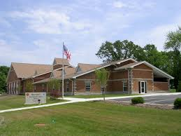
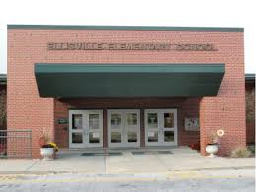
Special Districts Excluded from Metro City
“Special District” shall mean, excluding school districts, any political subdivision, municipal corporation, body corporate and politic, taxing district, taxing sub-district, public corporation or quasi-public corporation, other than a municipality
Examples – School District, Special School District, Junior College District, MSD, County Library District, Zoo-Museum District, Transportation Development Districts, Community Improvement Districts…
10

Slide 11
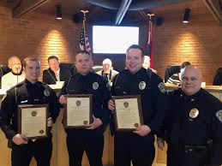
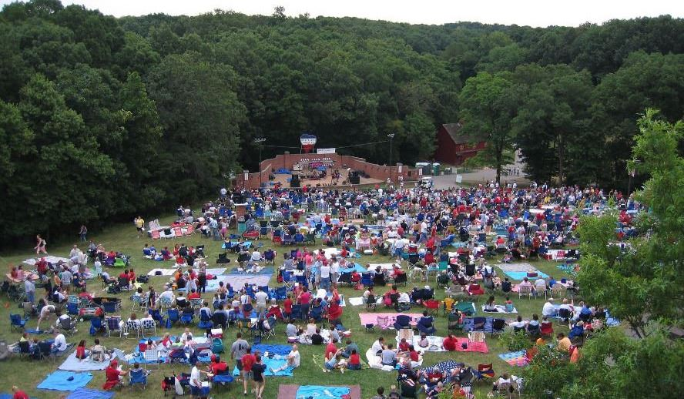
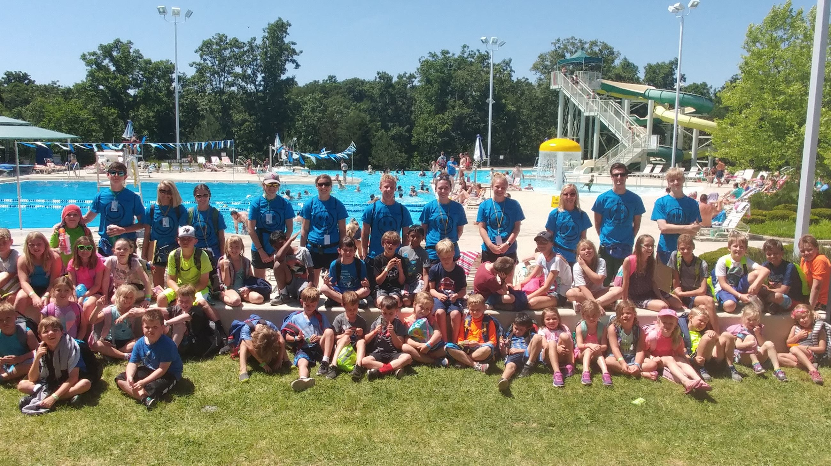
How does this affect us?
Residents of Ellisville would be significantly affected by this change.
We would lose local control and decision making that impacts our quality of life.
We would lose local access and accountability.
11

Slide 12

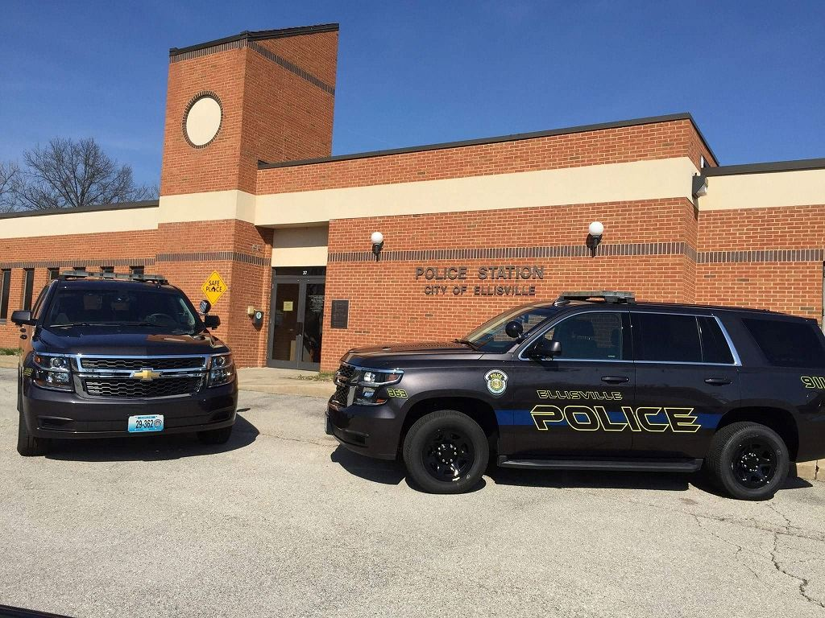
How does this affect us?
St. Louis, St. Louis County and all municipal police services would be combined into one mega police department. There would be no Ellisville Police Department; our own local police officers may not be available to take and respond to your calls for assistance.
12

Slide 13
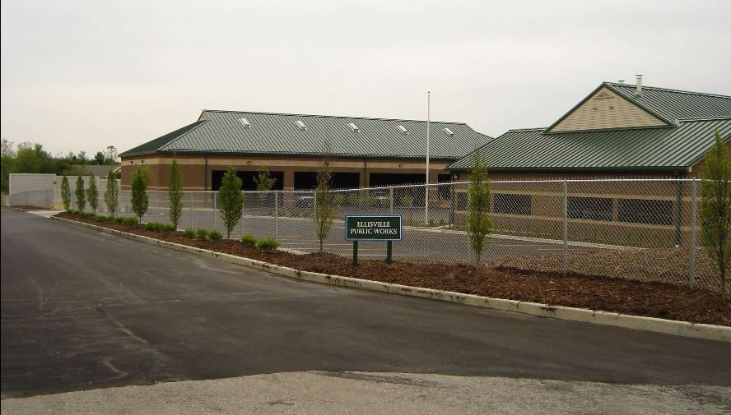
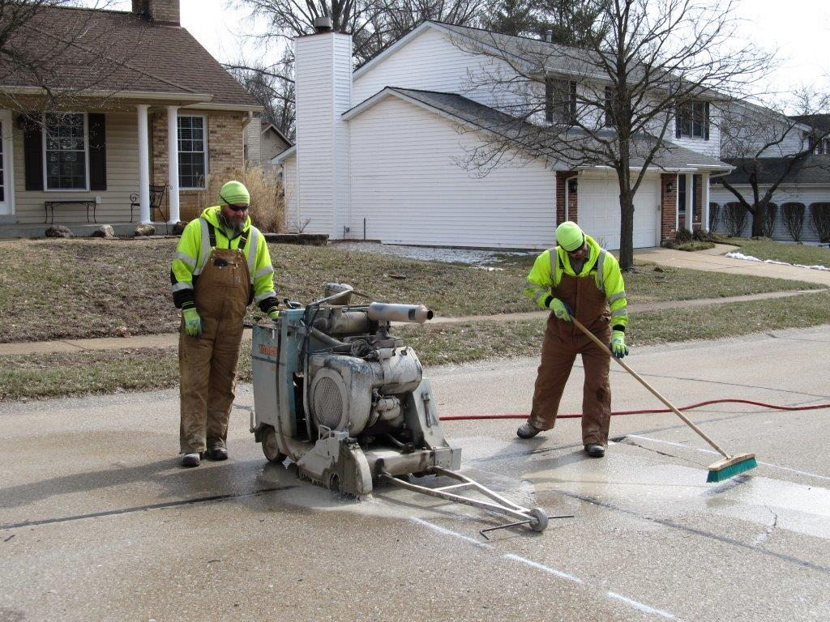
How does this affect us?
All municipal streets, sidewalks and bridges would become the property and responsibility of the new Metro government. There would be no Ellisville Public Works Department; our own local public work employees may not be there to plow your streets, fill pot holes, or take your calls for service.
13

Slide 14

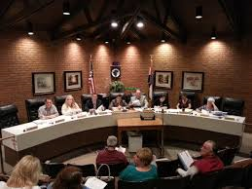
How does this affect us?
All municipal courts would be combined into one unit. The two circuit court districts servicing over St. Louis City and County would also be combined. There would be no Ellisville municipal courts; our own local court clerks may not be there to service your needs.
14

Slide 15


How does this affect us?
Local control over planning and zoning would cease. The New Metro City would be in charge of our planning and zoning. All permits and inspections would also be controlled by the Metro government.
15

Slide 16

As Residents We Will Be Asked To Decide,
Is “Better Together” better for Ellisville?
Under the Better Together's proposed plan, municipalities would be left with their parks system, trash service and limited planning functions.
?
16

Slide 17

Financing of Services
General City Services of the Metropolitan City to be funded primarily from sales taxes
Municipal District Services to be funded primarily from property taxes
Each municipal district is a sub-district of the Metro City and the Metro City can, with voter approval in the municipal district, levy different taxes within the municipal district to increase the level of general district services in the municipal district
17

Slide 18
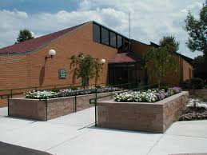
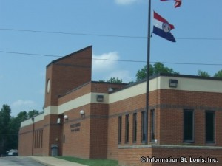
Property to be Transferred to Metro City
Property, contracts, records and personnel of municipal district relating to provision of a general district service shall be transferred to the Metro City
What is included in the term “property”? Land, buildings, equipment? We do not know.
Property encumbered by debt is not transferred until the debt is retired
18

Slide 19

Ellisville and other Municipal Revenues Redirected to Metro City are…
Sales and Use Taxes previously approved by Municipal Voters the municipality to remain in effect BUT REDIRECTED to Metro City
Taxes shared with “Cities”, such as, County Road & Bridge Refund, Cigarette Tax; State Gasoline, Motor Vehicle, and Motor Vehicle Fees
Municipal Court Revenues
Revenues from Business Licenses
Revenues from Land Use Regulations
Building Permit and Inspection Fees
In addition, earnings taxes in the City of St. Louis to be redirected to Metro City, but will be phased out over 10 years
19

Slide 20
Sales Taxes*
Sales Tax (currently received in Ellisville) | 2019 Ellisville Budget
1.25% General Sales Tax | $2,800,000
0.50% Park & Stormwater Sales Tax | $1,500,000
0.50% Capital Improvement Sales Tax | $1,270,000
0.25% Prop P Sales Tax | $490,000
Total | $6,060,000
* Estimate based on proposed Constitutional Amendment and Ellisville 2019 Budget
20

Slide 21

Sales Tax Distribution
All sales taxes levied by municipalities will continue as levied but shall be taxes paid to the METRO CITY
The Metro City SHALL pass thru to the municipal district those sales taxes dedicated to outstanding obligations (debt) of the municipal district
The Metro City MAY pass thru to the municipal district remaining sales tax revenues necessary for providing municipal district services
Any remaining sales tax revenues MAY be used by the Metro City to finance general district services in the Metro City
21

Slide 22
Other Revenues Redirected*
Revenue Source | Amount in 2019 Budget
Intergovernmental Revenues | $1,046,779
Licenses and Permits | $708,900
Municipal Court | $71,400
Miscellaneous Revenue | $210,000
Total | $2,037,079
* Estimate based on proposed Constitutional Amendment and Ellisville 2019 Budget
22

Slide 23

Ellisville’s options to make up for Budget Shortfalls
CUTS in GENERAL ADMINISTRATION COSTS
CUTS in PARKS, RECREATION, and ARTS SERVICES
ELIMINATE CITY PAYMENT FOR TRASH SERVICES
(Approx. $180 per home)
INCREASES IN PROPERTY TAXES, LICENSES AND FEES (with voter approval)
23

Slide 24
Ellisville District
Remaining Revenue Sources Under Better Together for Ellisville | Current Rates Levied by Ellisville | Additional Revenue Available to Ellisville
Real Estate Tax* | $0.1410 | $340,000
Sewer Lateral Fee | $28 | $94,000
Utility Taxes | 7.00% | $1,780,000
Park Revenue |  | $338,100
Total |  | $2,552,100
* Based on $100 per assessed value
24

Slide 25
Annual (Deficit) ($1,126,900)
Expenses for Remaining Operations Under Better Together for Ellisville |  | Estimated Reduced Expenditures **
Solid Waste & Recycling |  | $650,000
Local Zoning |  | $231,000
Sewer Lateral Program |  | $156,000
Park Maintenance & etc. |  | $941,000
Park & Recreation Programs |  | $1,701,000
Total |  | $3,679,000
Ellisville District
Annual (Deficit) ($1,126,900)
Deficit of approximately 45%.
25

Slide 26

Board of Freeholders Plan
The Municipal League of Metropolitan St. Louis has started a petition drive of its own, using the existing State Constitution to create a Board of Freeholders.
This petition is believed by the Municipal League to be an alternative approach to the state-wide vote process in that it:
  allows residents of St. Louis City and County only, reviewing and voting on the governmental structure of St. Louis City and County
  is already established in Article VI of the Missouri Constitution
  if signatures from this petition are certified, the Mayor of the City of St. Louis and the St. Louis County Executive have 10 days to each appoint nine eligible members to the Board and the Governor appoints one member (19 total members)
26

Slide 27
Board of Freeholders Plan
The City and County members must be approved by the Board of Aldermen and the County Council, respectively
The 19-member board is required to hold their first public meeting 30 days after the members are approved
The board can take up to 12 months to develop a plan
If the plan is approved by a majority of Freeholder members, the plan becomes available to the public for at least 90 days before a special election can take place.
27

Slide 28
Board of Freeholders Plan
The Municipal League of Metropolitan St. Louis’ goals are…
to conduct a transparent and deliberative exchange regarding the governmental structure and potential reforms involving the City and County
to utilize this process using citizen input and affirmative methods to address the need for change in our region
28

Slide 29

What can I do?
Talk to your friends, family, and neighbors
Get informed
Sign a petition (whichever you choose)
Talk to your elected officials; local, state and federal
29

Slide 30
What can I do?
If you have comments or concerns, contact your elected officials
Elected Officials:
Steve Stenger – County Executive -314.615.7016 – sstenger@stlouisco.com
Mark Harder – County Councilman – 314.615.5443 – mharder@stlouisco.com
Tim Fitch – County Councilman – 314.615.5438 – tfitch@stlouisco.com
Andrew Koenig – State Senator – 573.751.5568 – Andrew.Koenig@senate.mo.gov
Ann Wagner – U.S. Congresswomen – 636.779.5449 – wagner@house.gov
30

Slide 31
THANK
YOU!
City of Ellisville
Phone
636.227.9660
Website
www.Ellisville.MO.US

